Slide 1


CSE 470 –Control Flow Graph (Path Based Testing )
BRAC University

Slide 2
Control Flow Graph: Introduction
An abstract representation of a structured program/function/method.
Consists of two major components:
Node:
Represents a stretch of sequential code statements with no branches.
Directed Edge (also called arc):
Represents a branch, alternative path in execution.
Path:
A collection of Nodes linked with Directed Edges.

Slide 3
Notation Guide for CFG
A CFG should have:
1 entry arc (known as a directed edge, too).
1 exit arc.
All nodes should have:
At least 1 entry arc.
At least 1 exit arc.
A Logical Node that does not represent any actual statements can be added as a joining point for several incoming edges.
Represents a logical closure.
Example:
Node 4 in the if-then-else example in next slides

Slide 4
Simple Examples
Statement1;
Statement2;
Statement3;
Statement4;
Can be represented as one node as there is no branch.
1
CFG

Slide 5
More Examples
if X > 0 then
Statement1; else Statement2;
1
T
2
2
1
4
3
3
F
CFG
F
while X < 10 {
Statement1; X++; }
1
2
1
2
3
4
T
3
Question: Why is there a node 4 in both CFGs?
Answer: A logical node
CFG

Slide 6
More Examples
1
2
4
for (int I = 0; I < 10 ; I ++){
Statement1;
Statement2;
Statement3; }
Statement4;
3
5
5
F
1
2
3
4
T
CFG

Slide 7
Combined Examples
Statement1;
Statement2;
if X < 10 then
Statement3;
Statement4;
1
T
3
1
2
2
3
F
4
4
CFG

Slide 8
Number of Paths through CFG
Given a program, how do we exercise all statements and branches at least once?
Translating the program into a CFG, an equivalent question is:
Given a CFG, how do we cover all arcs and nodes at least once?
Since a path is a trail of nodes linked by arcs, this is similar to ask:
Given a CFG, what is the set of paths that can cover all arcs and nodes?

Slide 9
Example
T
3
1
2
1
F
4
CFG
CFG
Only one path is needed:
[ 1 ]
Two paths are needed:
[ 1 – 2 – 4 ]
[ 1 – 2 – 3 – 4 ]
T
2
1
4
Two paths are needed:
[ 1 – 2 – 4 ]
[ 1 – 3 – 4 ]
3
F
CFG

Slide 10
White Box Testing: Path Based
A generalized technique to find out the number of paths needed (known as cyclomatic complexity) to cover all arcs and nodes in CFG.
Steps:
Draw the CFG for the code fragment.
Compute the cyclomatic complexity number C, for the CFG.
Find at most C paths that cover the nodes and arcs in a CFG, also known as Basic Paths Set;
Design test cases to force execution along paths in the Basic Paths Set.

Slide 11
Path Based Testing: Step 1
min = A[0];
I = 1;
while (I < N) {
if (A[I] < min)
min = A[I];
I = I + 1;
}
print min
1
1
2
2
F
T
3
3
4
F
T
5
5
4
6
6
CFG

Slide 12
Path Base Testing: Step 2
1. The complexity M is then defined as
M = R + 1,
where R = the number of regions in the graph.
2. The complexity M is then defined as
M = P + 1,
where P = the number of predicate nodes in the graph.
3. The complexity M is then defined as
M = E − N + 2P,where
E = the number of edges of the graph.
N = the number of nodes of the graph.
P = the number of connected components.

Slide 13
Path Base Testing: Step 2
1
Cyclomatic complexity =
The number of ‘regions’ in the graph( R ) + 1
2
F
T
3
F
T
5
4
6
CFG

Slide 14
Path Base Testing: Step 2
1
Cyclomatic complexity, M =
The number of ‘regions’ in the graph( R ) + 1
= 2 +1 = 3
2
F
T
3
F
T
5
4
6
CFG

Slide 15
Path Base Testing: Step 2
M = Number of ‘predicate’ node (P) + 1
In this example:
Predicates, P = 2
(Node 2 and 3)
Cyclomatic Complexity, M
= 2 + 1
= 3
1
2
F
T
3
F
T
5
4
6
CFG

Slide 16
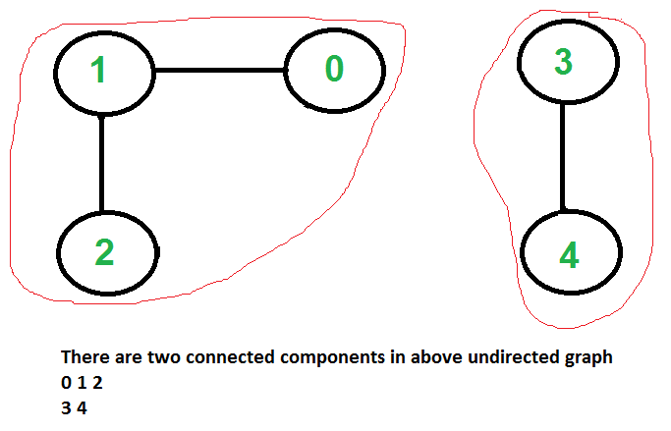
Path Base Testing: Step 2
Connected Components in a Graph

Slide 17
Path Base Testing: Step 2
1
Cyclomatic complexity, M = E − N + 2P
E, edges = 7
N, nodes = 6
P, connected components = 1
= 7 – 6 + (2x1)
= 3
2
F
T
3
F
T
5
4
6
CFG

Slide 18
Path Base Testing: Step 3
Independent path:
An executable or realizable path through the graph from the start node to the end node that has not been traversed before.
Must move along at least one arc that has not been yet traversed (an unvisited arc).
The objective is to cover all statements in a program by independent paths.
The number of independent paths to discover <= Cyclomatic complexity number, M
The set of Independent paths is called Basic Path Set

Slide 19
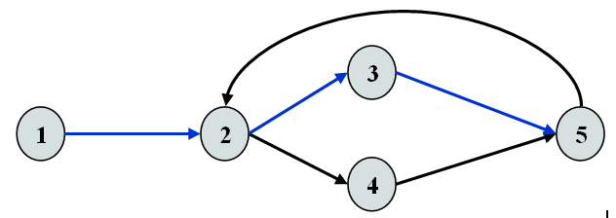
Example
M = Regions + 1 = 2 + 1 = 3
1-2-3-5 can be the first independent path; 1-2-4-5 is another; 1-2-3-5-2-4-5 is one more.
Alternatively, if we had identified 1-2-3-5-2-4-5 as the first independent path, there would be no more independent paths.
The number of independent paths therefore can vary according to the order we identify them.

Slide 20
Path Base Testing: Step 3
Cyclomatic complexity = 3.
Need at most 3 independent paths to cover the CFG.
In this example:
[ 1 – 2 – 6 ]
[ 1 – 2 – 3 – 5 – 2 – 6 ]
[ 1 – 2 – 3 – 4 – 5 – 2 – 6]
1
2
F
T
3
F
T
5
4
6
CFG
Notes:
Dirichlet Principle: Given n boxes and m>n objects, at least one box must contain more than one object.
Example: Lamar elevator: Given Lamar University Library building, if there are 8 people in the elevator at the ground floor, then there exists a floor where two people will get off. (knowing that the Lamar University Library building has 8 floors – including ground floor).

Slide 21
Path Base Testing: Step 4
Prepare a test case for each independent path.
In this example:
Path: [ 1 – 2 – 6 ]
Test Case: A = { 5, …}, N = 1
Expected Output: 5
min = A[0];
I = 1;
while (I < N) {
if (A[I] < min)
min = A[I];
I = I + 1;
}
print min
1
2
3
4
5
6
Try to verify that the test cases actually force execution along a desired path.

